Slide 1

Portfolio Construction Algorithm for US Equities
Adil Gazder, Chris Moreira, Danish Maknojia, Vishesh Gupta
IDS 789: Fundamentals of Finance
Fall 2024
Duke University

Slide 2

NON - TECHNICAL PROJECT
01
The skills, roles and responsibilities needed as a Quantitative Research Intern at Two Sigma

Slide 3
Two Sigma
Company Overview
Founded in 2001 by David Siegel and John Overdeck.
A financial science company leveraging advanced technology, data science, and human inquisitiveness.
Quantitative Research Internship
Program Highlights
Duration: 10 weeks at NYC headquarters.
Core Activities:
Partner with mentors to solve complex financial problems.
Develop sophisticated investment models using quantitative methods.
Apply machine learning techniques to diverse datasets.
Collaborate with engineers to test and refine algorithms.

Slide 4
Two Sigma
Ideal Candidate Skills
Strong background in quantitative fields (math, CS, physics, etc.).
Proficient in programming languages like Python, C++, or Java.
Independent thinker with the ability to analyze and communicate insights effectively.
Our Fit
MIDS program equips us with:
Expertise in machine learning, data analysis, and quantitative finance.
Experience with real-world datasets and statistical modeling techniques.
Strong alignment between program curriculum and internship requirements.

Slide 5
TECHNICAL PROJECT
02
Portfolio construction algorithm for US Equities

Slide 6
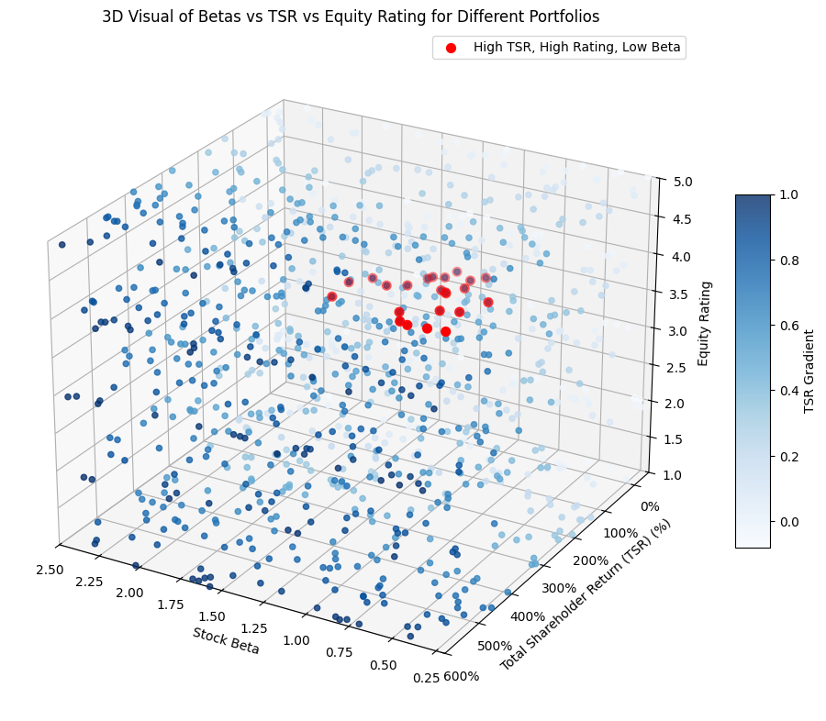
Problem Statement
Construct a portfolio optimization algorithm that focuses on:
Maximizing Total Shareholder Return (TSR)
Leverages volatility through equity beta
Relies on Equity Ratings for weight allocations

Slide 7
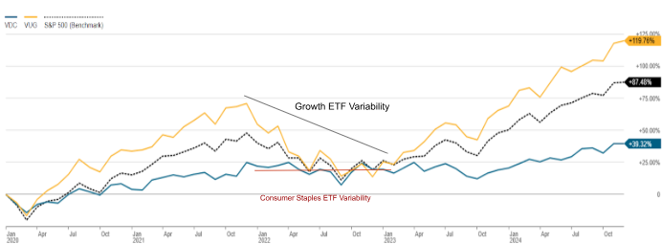
Industry Type Vs. Broad Market
Typical Tradeoffs:
Volatility (Defensive)
Dividends (Defensive)
Price Appreciation (Cyclical)
Defensive Industries: Healthcare, Utilities, Consumer Staples
Cyclical Industries: Real Estate, Technology, Industrials

Slide 8
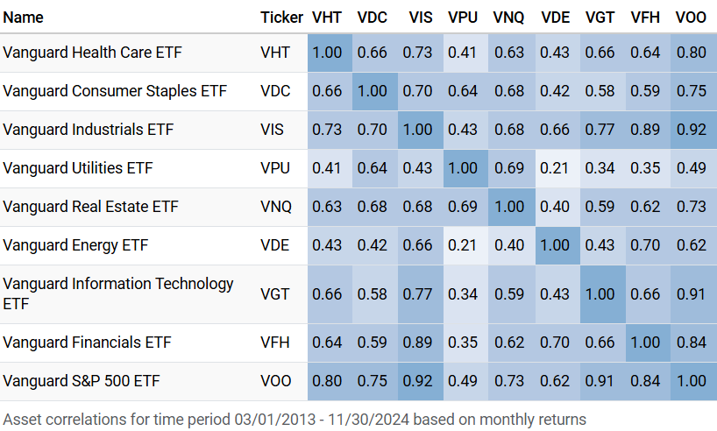
Industry Correlations Coefficients
Utilities & Energy: Exhibit Low Correlation to Broad Market and other industries (Tends to Outperform in bullish markets)
Technology, Industrials & Financials: Exhibit strong correlation to Broader Market(Outperforms in Market Expansion Periods)

Slide 9
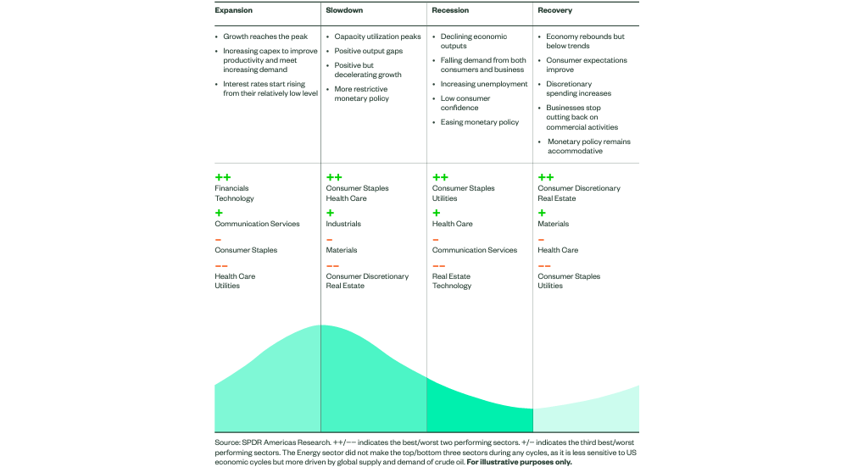
Sector Performance in Different Market Conditions

Slide 10
Approach and Modeling

Slide 11
Risk Mitigation
Reduce the risk from sector specific downturns while maintaining a balance between cyclical ( eg: Technology) and defensive (eg: Utilities) industries
Market Volatility
Description: Sector performance is cyclical and sensitive to economic shifts.
Examples: Interest rate changes, inflation spikes.
Technological Disruption
Description: Innovations can disrupt existing business models.
Impact: Forces adaptation; creates winners and losers.
Concentration Risk
Description: Overexposure increases vulnerability to sector-specific downturns.
Impact: Reduces diversification benefits.
Commodity Price Fluctuations
Description: Reliance on volatile commodity prices affects profitability.
Affected Sectors: Energy, materials, industrials.
Regulatory & Policy Changes
Description: Government interventions can alter sector dynamics.
Examples: Tax reforms, environmental regulations.
Competitive Dynamics
Description: High competition pressures margins and market share.
Challenge: Entry of new players intensifies rivalry.

Slide 12
Equity Variables
Key Metrics:
Equity Rating
Analysts (i.e. us) assigned grades from A to F based on financial performances.
Data Sources: Macrotrends.net & Bloomberg Terminal
Based on metrics like:
P/E Ratio
P/B Ratio
Company Analysis
Beta
Measure stock volatility to the market
Total Shareholder Return (TSR)
Capture capital appreciation over 5 years
These metrics were picked as it provides us with a balance in growth, risk and quality of stock

Slide 13
Fundamental Research
We performed the fundamental analysis of 80 companies to identify:
Revenue growth potential
Diversification opportunities
Risk factors impacting growth
Key Analytical Steps:
Revenue Analysis:
Evaluated historical and projected revenues.
Assessed revenue stream diversity and scalability.
Identified key revenue generators and market sustainability.
Expense Analysis:
Reviewed cost structure: gross and operating margins.
Benchmarked expenses (R&D, marketing, administrative) against industry norms.
Comp Analysis:
Compared company with industry peers

Slide 14
Algorithm Design

Slide 15
Initial Algorithm - Key Components
Grade Weight
Weightage allocation based on fundamental analysis: A = 90% ….. F = 40%
Normalised TSR
Adjusted TSR within industries for comparability
Grade Score Formula
Objective function to be optimized
Constraints
Portfolio beta < 1.0
Max Industry Allocation = 16%
Grade Score = ((1 - y) * TSR) + (y * GW)
TSR: Total Shareholder Value
GW: Grade Weight
y: Random weights ranging from 0.65 - 0.8

Slide 16
Issues with the algorithm
We are randomly picking a weight that meets the constraints rather than optimizing for the lowest beta value
There are stocks that take more than 7% of the portfolio which we must restrict
On weight rebalancing we are exceeding the 16% threshold set previously

Slide 17
Refined Algorithm
Share Weightage Restrictions
To ensure no over-exposure to a particular stock and adequate diversification to address market volatility, we chose to limit the maximum weightage of any stock to not more than 4.5% of the total portfolio.
Sector (SPDR ETF Ticker) | Weightage (As % of total portfolio)
Consumer Staples (XLP) | 11%
Energy (XLE) | 13%
Finance (XLF) | 15%
Healthcare (XLV) | 14%
Industrials (XLI) | 13%
Real Estates (XLRE) | 9%
Technology (XLK) | 15%
Utilities (XLU) | 10%
Sectoral Weightage Restrictions
To mitigate sector-specific risks, we also ensured that as a result of our optimization algorithm, the weightage of each sector does not exceed more than 16% of the entire portfolio
Objective Function Optimization
We iterated over 15000 values between 0.65 and 0.8, ran the model for each of these scenarios, and generated the portfolio with the lowest beta as a deterministic output from our algorithm.

Slide 18
Algorithm Results

Slide 19
Model Results - Portfolio Highlights
Highest weighted (Top 10) stocks in our portfolio
Company Name | Industry | Beta Value | Grade | TSR | Grade Weight | Final Weight
Nvidia (NVDA) | Technology | 1.76 | C | 2694.86 | 70 | 4.5
Tesla (TSLA) | Technology | 2.12 | A | 1236.11 | 90 | 4.5
Eli Lilly and Company (LLY) | Healthcare | 0.42 | C | 675.16 | 70 | 3.669877
Interactive Brokers (IBKR) | Finance | 0.79 | D | 303.51 | 60 | 1.966827
LPL Financial (LPLA) | Finance | 0.85 | C | 276.95 | 70 | 1.931962
CATERPILLAR INC. (CAT) | Industrials | 0.95 | A | 225 | 90 | 1.867339
The Williams Companies | Energy | 1.06 | C | 248.45 | 70 | 1.807579
Morgan Stanley (MS) | Finance | 1.34 | B | 219.69 | 80 | 1.763113
Raymond James Financial (RJF) | Finance | 1 | A | 196.37 | 90 | 1.742389
Goldman Sachs (GS) | Finance | 1.35 | B | 211.02 | 80 | 1.725274

Slide 20
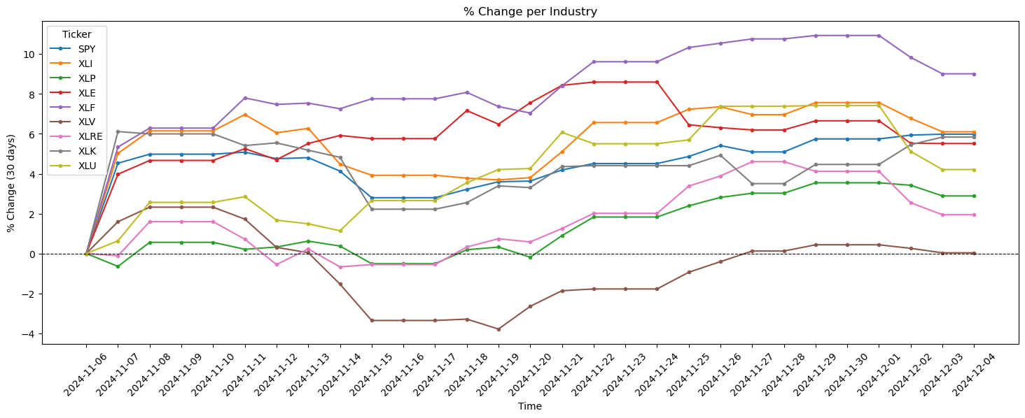
Model Results - Industry Landscape
Sectoral SPDR ETFs - Overall returns between 11/05/2024 - 12/04/2024
XLF
Finance ETF with the highest return of 9.01%
SPY
S&P 500 ETF return of 5.98%
XLV
Healthcare ETF with the lowest return of 0.03%
Illustrates the importance of diversification to avoid sector - specific risks
The SPY outperforms 6 out of 8 sectoral ETFs
Our portfolio outperforms all 8 sectors and the S&P 500 ETF during this time period
Backtesting Data: Yahoo Finance
Calculated as Adjusted Closing Price for each trading day

Slide 21
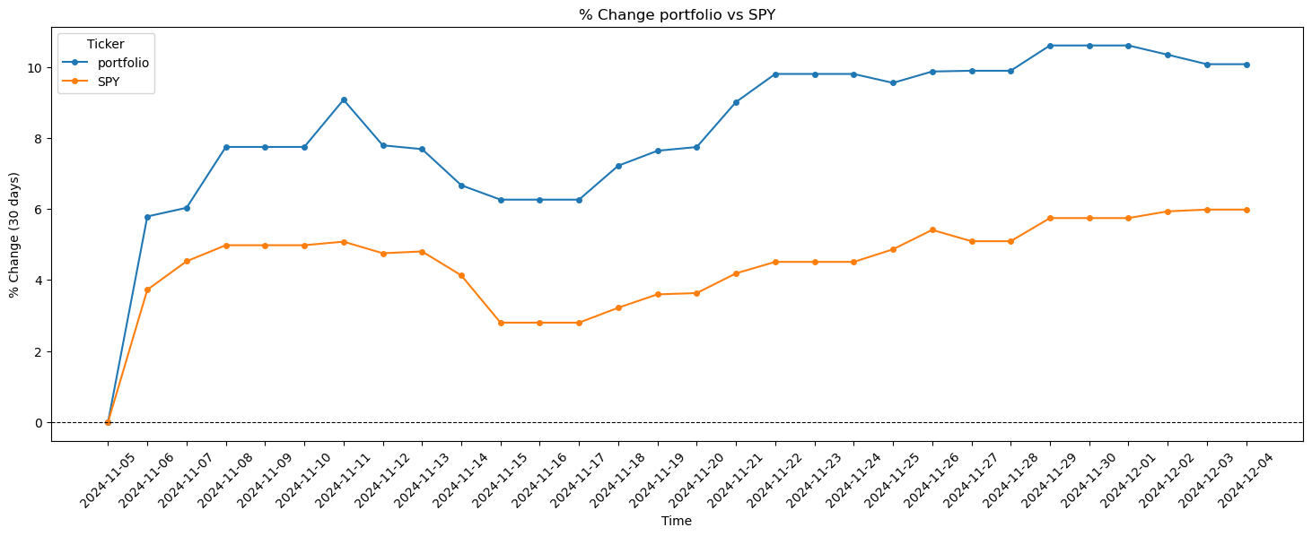
Model Results - Portfolio vs SPY
Overall returns between 11/05/2024 - 12/04/2024
US Elections
Fed Interest Rate Decision
Inflation Rate and CPI declaration
Thanksgiving Day
10%
Portfolio returns over the past 30 days
6%
S&P 500 ETF returns over the past 30 days
5.6%
Unweighted returns of the 8 industries over the past 30 days
Calculated as Adjusted Closing Price for each trading day

Slide 22
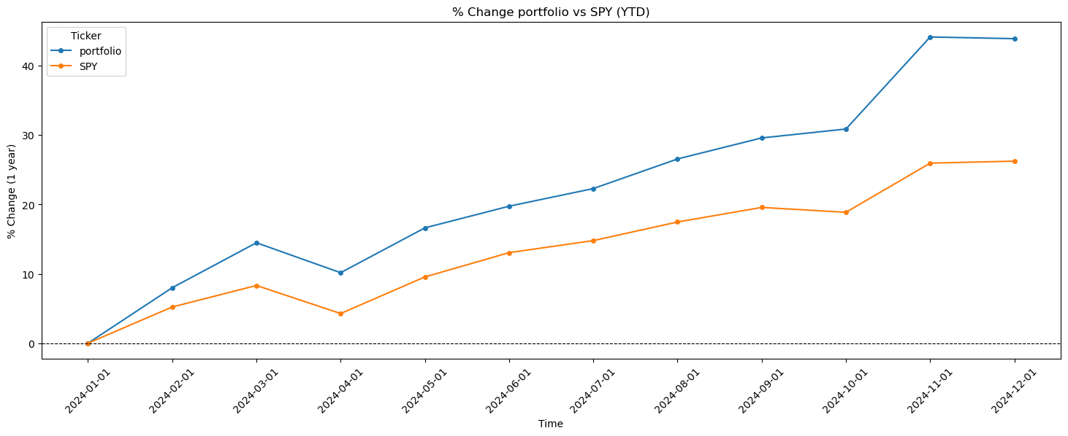
Model Results - Portfolio vs SPY
Overall YTD returns
Portfolio Average returns (MoM): 4%
Portfolio Standard deviation: 4.6%
44%
Portfolio returns over the past year (2024 - YTD)
26%
S&P 500 ETF returns over the past year (2024 - YTD)
Calculated as Adjusted Closing Price for each trading day (YTM returns)

Slide 23
Conclusion
Designed an algorithm which would be able to deliver alpha returns with minimal risk.
Performed in-depth fundamental analysis on these stocks and assigning a grade indicating the strength of these fundamentals along with the Total Shareholder Return (TSR).
Iterated over a range weight values by restricting the range to optimize the objective function.
Our portfolio was able to outperform both sectoral indexes and the SPY over a 30 day and YTD timelines.
Looking ahead, our aim would be to fine tune this portfolio to ensure it can deliver alpha returns in all-weather market conditions ensuring our portfolio returns are immune to economical and seasonal volatility.
80
Stocks under consideration across 8 sectors
0.89
Overall portfolio Beta value
44%
YTD Returns for 2024

Slide 24
THANK YOU!
Duke University
IDS 789 - Fundamentals of Finance
Fall 2024
Please keep this slide for attribution

